Slide 1
It’s Time to Talk Turkey--- Industry and Government Prepare for Year–end Planning & Closeout and Fine Tune Provisional Rates
TIDEWATER GOVERNMENT INDUSTRY COUNCIL www.tasc-tgic.org
By
Jacob Barclay and Beverly Arviso

Slide 2
Objectives
TIDEWATER GOVERNMENT INDUSTRY COUNCIL www.tasc-tgic.org
Understand the difference between FPRP, FPRA, FPRR, and Provisional Billing Rates
Considerations in establishing and updating Forward Pricing and Provisional Billing Rates
Information and analysis to include in your Forward Pricing Rate Proposal
Short Term, Mid-Term and Long Term Budgetary Data
Adjusting Billing Rates and cash flow considerations
DCAA Adequacy Reviews, Audits, and Audit guidance
Supporting your rates during a DCAA/DCMA review

Slide 3
TIDEWATER GOVERNMENT INDUSTRY COUNCIL www.tasc-tgic.org
Government Contract Rate Cycle

Slide 4
Government Contract Rate Lifecycle
TIDEWATER GOVERNMENT INDUSTRY COUNCIL www.tasc-tgic.org
Forward Pricing Rate Proposal (FPRP)
Forward Pricing Rate Recommendation (FPRR) or
Forward Pricing Rate Agreement (FPRA)
Provisional Billing Rates
Final Billing Rates

Slide 5
Forward Pricing Rate Proposals (FPRPs)
TIDEWATER GOVERNMENT INDUSTRY COUNCIL www.tasc-tgic.org
Direct labor rates
Indirect expense rates
Corporate allocations
Interdivisional allocations
Intermediate cost pools
Shared services
Cost of money factors
Business forecast/allocation bases
Trends and budgetary data
Comparative analysis
Use of historical data
Comparison of forecasted rates to historical rates
Rate monitoring and updates
Large vs. small companies – level of detail

Slide 6
FPRR and FPRA
TIDEWATER GOVERNMENT INDUSTRY COUNCIL www.tasc-tgic.org
Forward Pricing Rate Recommendations (FPRRs) and Forward Pricing Rate Agreements (FPRAs)
Negotiation of FPRAs may be requested by the contracting officer, the contractor, or initiated by the ACO.
FPRAs are becoming rare
Inadequate contractor submissions
Ongoing monitoring activities
In the absence of FPRAs, DCMA will establish FPRRs based on DCAA input until DCAA audit is complete.

Slide 7
Provisional Rates (FAR 42.704)
TIDEWATER GOVERNMENT INDUSTRY COUNCIL www.tasc-tgic.org
Provisional (forward pricing) rates are sometimes utilized for both pricing and billing.
“Provisional” implies subject to change and approved on an interim basis by DCMA/DCAA.
Programs and projects can enter and leave the business base earlier or later than planned. For these reasons actual experience in terms of indirect rates may differ (+or-) from provisional rates.
Provisionally billed rates must be periodically compared to actual rates and reconciled to actual rates at contract closeout (also at least annually) for cost-plus and time and material contracts.

Slide 8
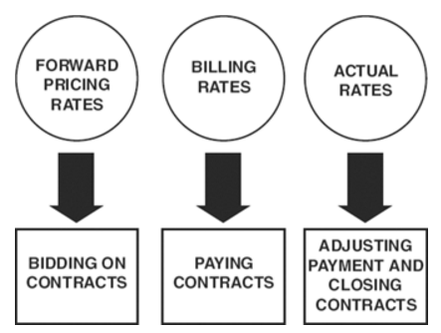
The ICS and the Indirect Rate Cycle
TIDEWATER GOVERNMENT INDUSTRY COUNCIL www.tasc-tgic.org
The Incurred Cost Submission (ICS) is a contractor submission to the Government to “true-up” Provisional (Forward Pricing) Rates to Actual Rates as a part of the Indirect Rate Cycle.
Your ICS rates are comprised of costs which are allocable, reasonable, and allowable on Government contracts.
- Contractor Indirect Rate Cycle
Bid and bill with Provisional rates
Monitor the Provisional rates versus Actual rates periodically.
Compare the rates at the end of year, at ICS submittal, and when the ICS is settled.
Submit revised rates if there is a material difference throughout contract
Submit final rates in ICS
Settle final rates at contract closeout

Slide 9
Indirect Rate Cycle – Rate Monitoring
TIDEWATER GOVERNMENT INDUSTRY COUNCIL www.tasc-tgic.org
Rates must be monitored by the contractor and may be adjusted as necessary throughout the year (FAR 42.704(c) and FAR 52.216-7(e))
Protects the Contractor and the Government
Review indirect rates on a regular basis
Monitoring Over/Under Billings per contract
Once material rate variances are evident, submit adjusting invoices timely
Ensures payment to the contractor prior to exhausting of funding
In current budget environment the contractor is wise to recover actual costs as quickly as possible
No cash flow or financial statement surprises if regularly reviewed

Slide 10
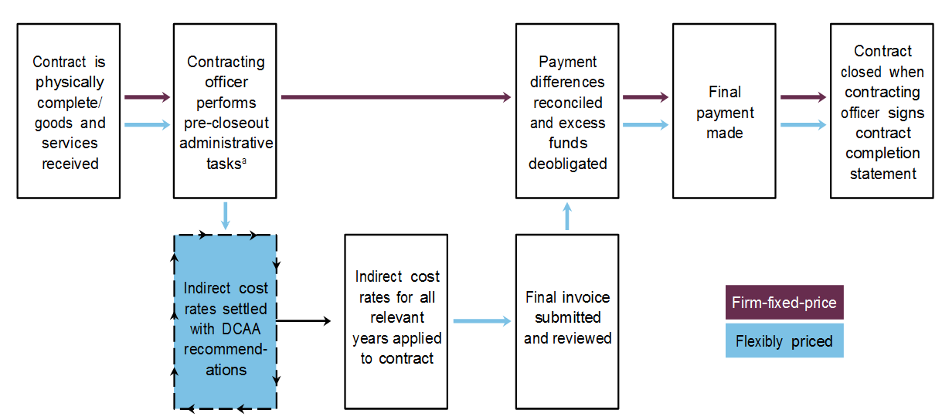
Indirect Rate Cycle – Contract Closeout
TIDEWATER GOVERNMENT INDUSTRY COUNCIL www.tasc-tgic.org

Slide 11
TIDEWATER GOVERNMENT INDUSTRY COUNCIL www.tasc-tgic.org
Compliance and Audit Scrutiny

Slide 12
Where and when do I submit?
TIDEWATER GOVERNMENT INDUSTRY COUNCIL www.tasc-tgic.org
Where?
The office responsible for final indirect cost rates also establishes provisional billing rates. (FAR 42.704)
If final rates are ACO determined, submit to that office.
If final rates are audit determined, submit to local DCAA Office.
When?
Before the beginning of the fiscal year (once budgets are complete) or when the established billing rates are no longer representative of final year end rates.
Rates should represent a 12-month contractor’s fiscal year
PBRs should be submitted at least annually
Vouchers and progress payments can be returned if submitted without properly established billing rates.

Slide 13
DCAA Adequacy
TIDEWATER GOVERNMENT INDUSTRY COUNCIL www.tasc-tgic.org
DCAA has published an Adequacy Checklist for Forward Pricing Rate Proposals
http://www.dcaa.mil
DFARS Adequacy Checklist
http://www.acq.osd.mil/dpap/dars/dfars/html/current/215_4.htm#215.403-5

Slide 14
DCAA Adequacy Reviews
TIDEWATER GOVERNMENT INDUSTRY COUNCIL www.tasc-tgic.org
Management approved operating budgets
Trends
Historical data
Corporate, home office and shared service allocations
Business base – bid and proposal data
Support for adjustments and judgmental factors

Slide 15
DCAA Audit Guidance
TIDEWATER GOVERNMENT INDUSTRY COUNCIL www.tasc-tgic.org
10-PSP-021, 8/24/10 – Audit Alert Related to Budgetary Data Supporting Forward Pricing Rates (www.dcaa.mil)
Use of trends and budgetary data
Large contractors – first year based on detailed management approved operating budget
Subsequent years – based on adjustments to operating budget based on strategic and long range forecasts

Slide 16
DCAA Audit Guidance
TIDEWATER GOVERNMENT INDUSTRY COUNCIL www.tasc-tgic.org
Level of detail will decrease as period being estimated moves forward
Adjustments to out year pools and bases should be based on reasonable sales forecasts
Extend of detail based on size and complexity of contractor
Smaller contractors generally do not develop detailed budgets – use trend data and history

Slide 17
DCAA Audit Guidance
TIDEWATER GOVERNMENT INDUSTRY COUNCIL www.tasc-tgic.org
13-PSP-019(R), 8/23/13 – Audit Alert on DCMA Forward Pricing Rate Process Change and DCAA Forward Pricing Rate Audit Process (www.dcaa.mil)
Encourages completion of FPRR within 30 days of FPRP receipt and to start FPRA negotiations within 60 days.
Audit teams should continue their FPRP audits expeditiously, including when the ACO is in the process of negotiating a FPRA or has established a FPRA/FPRR.

Slide 18
DCAA Audit
TIDEWATER GOVERNMENT INDUSTRY COUNCIL www.tasc-tgic.org
Some example procedures DCAA may perform include the following:
Contractor walkthroughs
Understand submission
Estimating methodology
Location of cost/pricing data
Cost rate monitoring process
Compare proposed pool and base to prior year and year-to-date pool and bases.
Review trend of questioned costs in relevant incurred cost audits and consider an adjustment for unallowable expenses in calculating current year provisional billing rates.

Slide 19
Rate Analysis Example
TIDEWATER GOVERNMENT INDUSTRY COUNCIL www.tasc-tgic.org

Slide 20
Provisional Rate Requirements
TIDEWATER GOVERNMENT INDUSTRY COUNCIL www.tasc-tgic.org
Proposed billing rate calculations (Pool and Base) with descriptions
Prior fiscal year (FY) pool and base
Current FY to date pool and base
Current FY budget pool and base, if available
Comparative analysis with explanation of any significant differences

Slide 21
Common Deficiencies
TIDEWATER GOVERNMENT INDUSTRY COUNCIL www.tasc-tgic.org
Failure to use historical data
Absence of analytical support
Excessive reliance on personal judgment
Failure to integrate relevant information from other management systems
Lack of business base support
Lack of trend and budgetary data
Use of operating budgets
Use of mid term and long term budgetary data
Failure to remove unallowable costs from the billing rate projections
Failure to adjust provisional billing rates based on actuals if there are known significant variances

Slide 22
TIDEWATER GOVERNMENT INDUSTRY COUNCIL www.tasc-tgic.org
Budgeting

Slide 23
Why Budget
TIDEWATER GOVERNMENT INDUSTRY COUNCIL www.tasc-tgic.org
Provides a guide for achieving the company goals
Provides a baseline for measuring performance
Business as a whole
Business lines
Manager performance
Assists with developing a pricing model for proposals
Development of indirect rates
Increasing the likelihood of cost recovery
Provisional rates reflect the expected reality
Assists with obtaining external financing
Demonstrates a commitment to sound business practices
Potential lenders can be eased about the quality of the company’s financial management skill.

Slide 24
Short Term and Long Term Budgeting
TIDEWATER GOVERNMENT INDUSTRY COUNCIL www.tasc-tgic.org
Use of trends and budgetary data
First year based on detailed management approved operating budget
Subsequent years – based on adjustments to operating budget based on strategic and long range forecasts
Level of detail will decrease as period being estimated moves forward
Adjustments to out year pools and bases should be based on reasonable sales forecasts
Extent of detail based on size and complexity of contractor
Smaller contractors generally do not develop detailed budgets – use trend data and history

Slide 25
TIDEWATER GOVERNMENT INDUSTRY COUNCIL www.tasc-tgic.org
Other Considerations

Slide 26
DCAA Audit
TIDEWATER GOVERNMENT INDUSTRY COUNCIL www.tasc-tgic.org
Cash Management
In the current Federal budget environment it is important to look at areas where cash is currently being held by the Government or Prime Contractors.
Some of the more common withholds are associated with indirect rate variances on cost reimbursement contracts and withholds of fees.
It is the obligation of the Contractor to ensure that they receive what is due, and reduce the risk of delays in payment or putting the entire amount at risk due to funding issues.
Financial Management
- Are we profitable on a per contract basis?

Slide 27
Questions
TIDEWATER GOVERNMENT INDUSTRY COUNCIL www.tasc-tgic.org
Jacob Barclay, Senior Consultant
Dixon Hughes Goodman LLP
Jacob.Barclay@dhgllp.com
757.624.5167
Beverly Arviso, CPA, CPCM, CFCM, NCMA Fellow
Arviso, Inc.
beverly@arvisoinc.com
757-373-9536

